Slide 1

Acceptance Test
Driven Development
Toby Weston
Ben Lithgow-Smith
James Mullineux

Slide 2
Learning Objectives
Understanding the basics of acceptance testing
Understanding how we agree acceptance criteria
Understand how to breakdown requirements
Understand the importance of iterating on understanding
Understand the correct application of abstraction in ATDD
Some pitfalls
Notes:
These should map to https://xpdojo.org/docs/lessons/02/atdd.html
Understanding the basics (of acceptance testing, what it is and its relationship with TDD)
Understanding how we agreeing acceptance criteria (with actual human customers and write those as living “specifications”)
Understand how to breakdown requirements (into small deliverables that can be demo’ed to the customer)
(related to the previous one) Understand the importance of iterating on our understanding (to get early feedback and “shift left”)
Understand the correct application of abstraction in ATDD (so that we can build large maintainable testing infrastructure that scales with our apps).
Some pitfalls

Slide 3
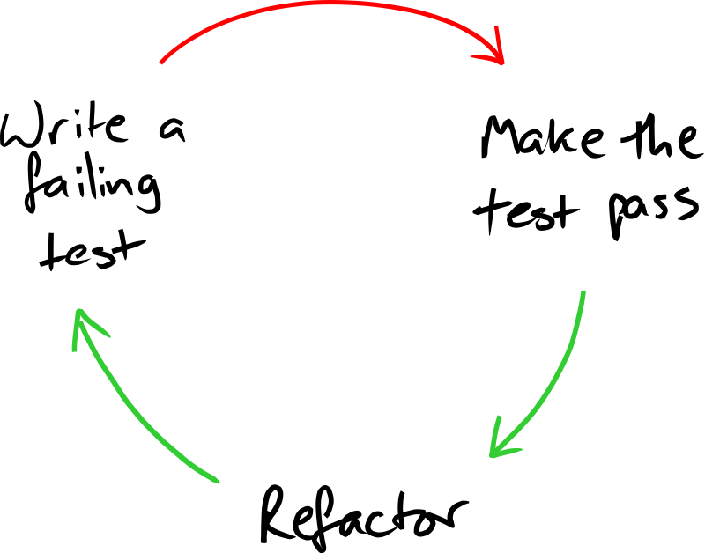

Notes:
Prompt: acknowledge Nat Pryce and GOOS

Slide 4
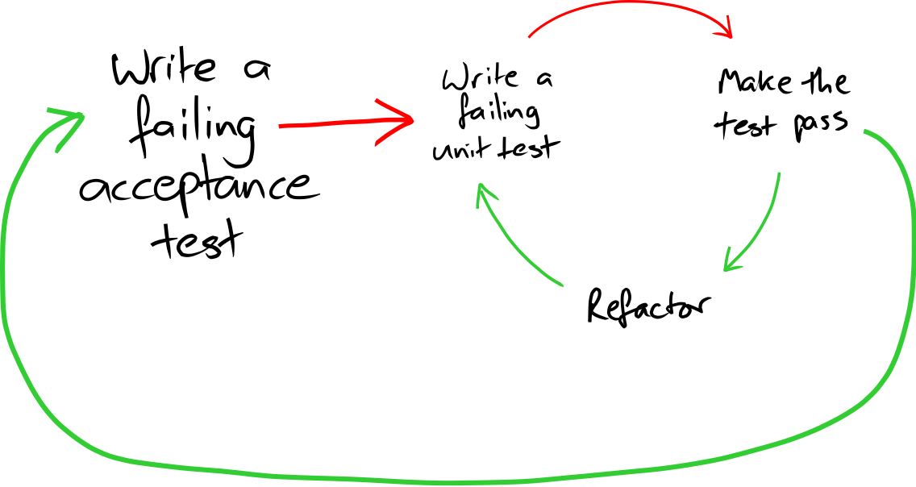

Slide 5
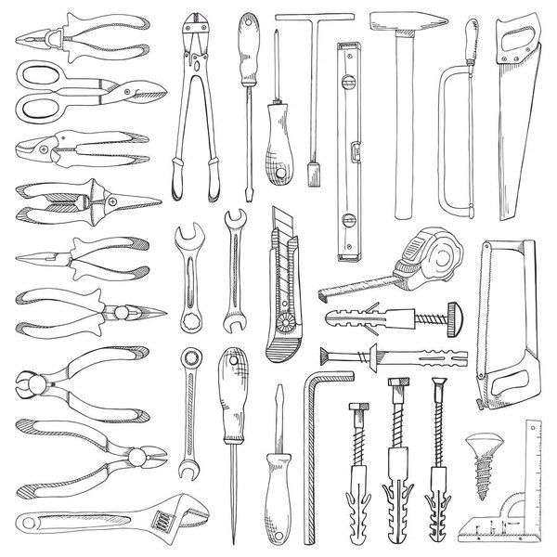
Notes:
Tools.
There are a bunch of tools that can support us in this endeavour

Slide 6
Notes:
Mention:
Gherkin in the same sentence as Cucumber (the former is the natural language parser)
Fit in the same sentence as FitNesse (the former is the predecessor and is in use by no sane person)
For the purpose of this session, we’ll be looking at Concordion.

Slide 7
Notes:
David’s connection to BSkyB, Nat and Steve etc

Slide 8
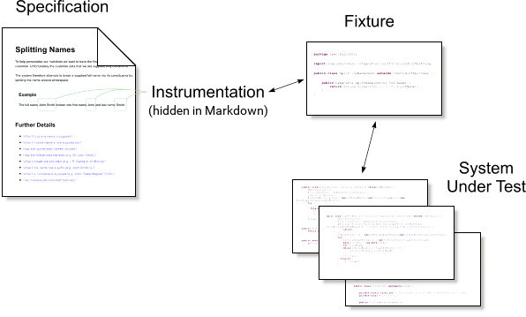

Slide 11
ACCOUNT
Notes:
What are we doing?
We’re building on the bank account system your TDD’ed in the previous session and we’re going to ask you to implement additional features.
To help get you started, here’s an example

Slide 12
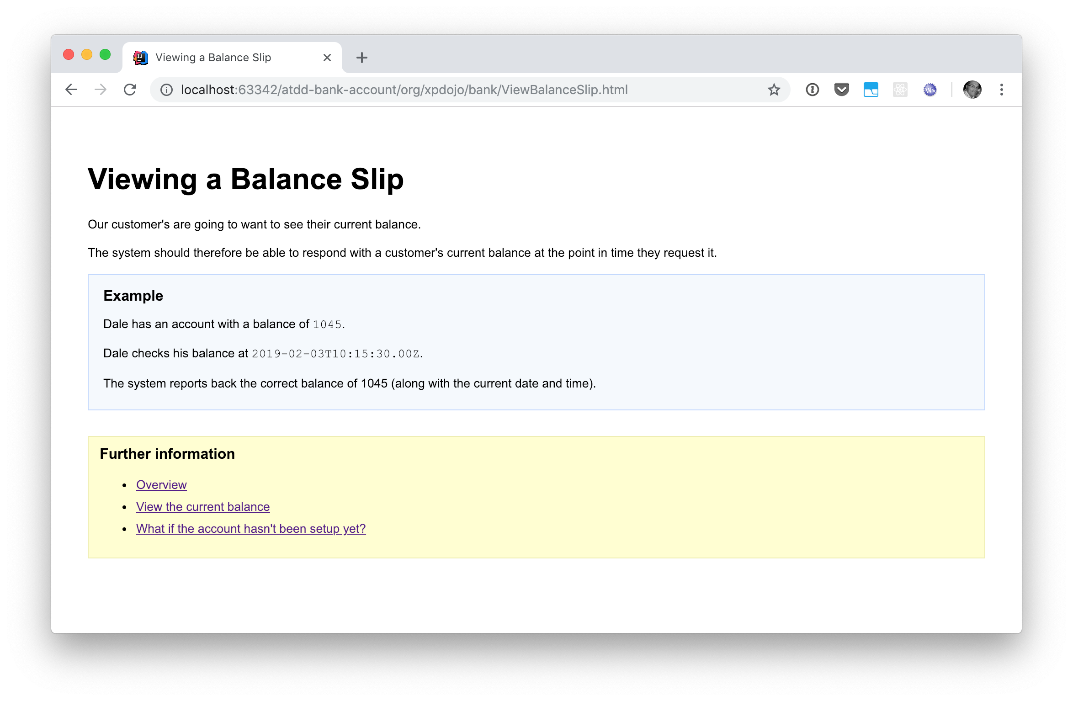
The Specification
Notes:
This is the “specification”

Slide 13
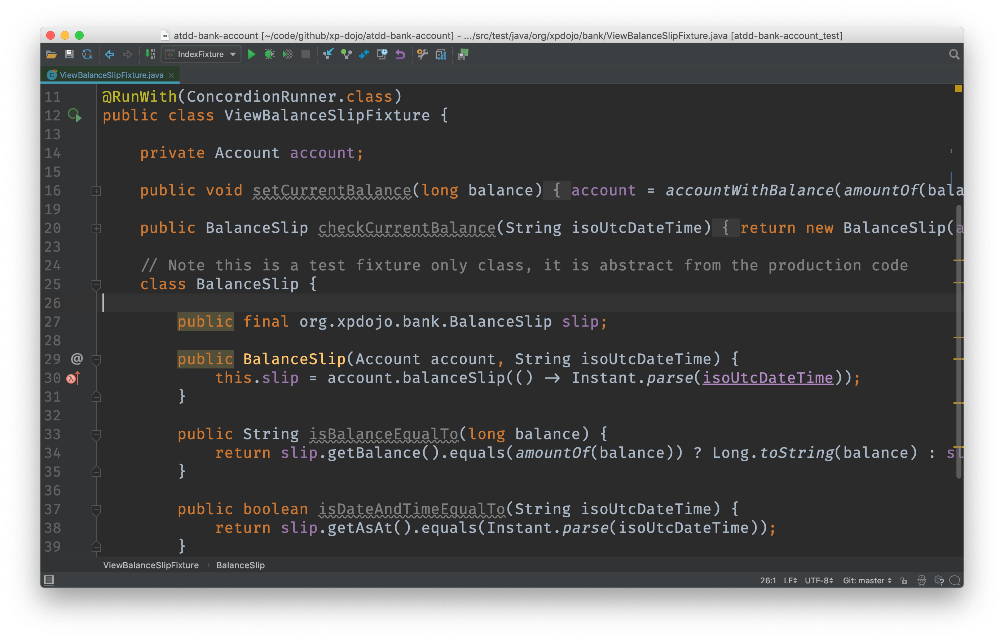
The Fixture
Notes:
This is the “fixture”

Slide 14
The System Under Test
Notes:
This is the “system under test”

Slide 15
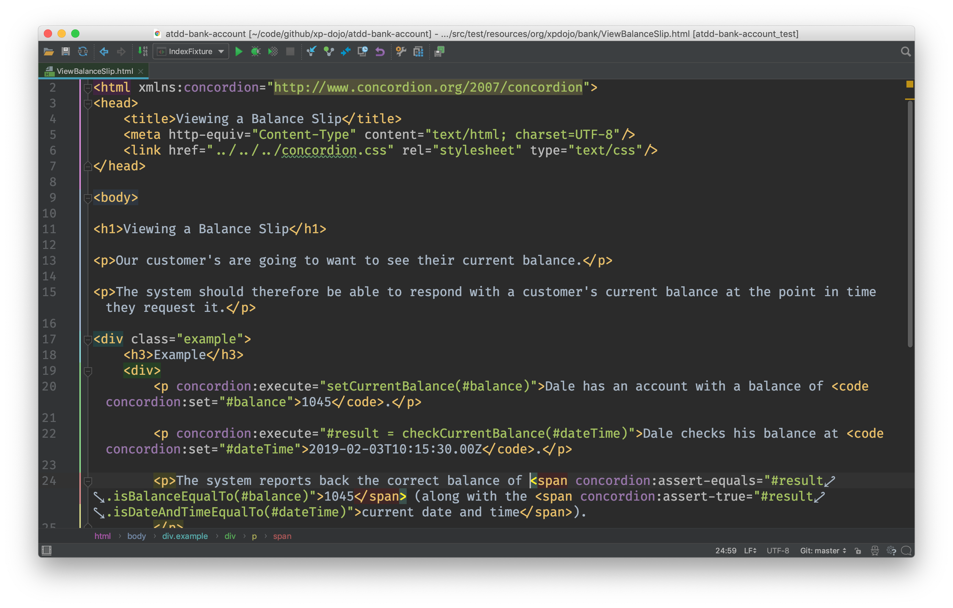
Instrumentation
Notes:
This is how you glue them together (by instrumenting the specification)

Slide 16
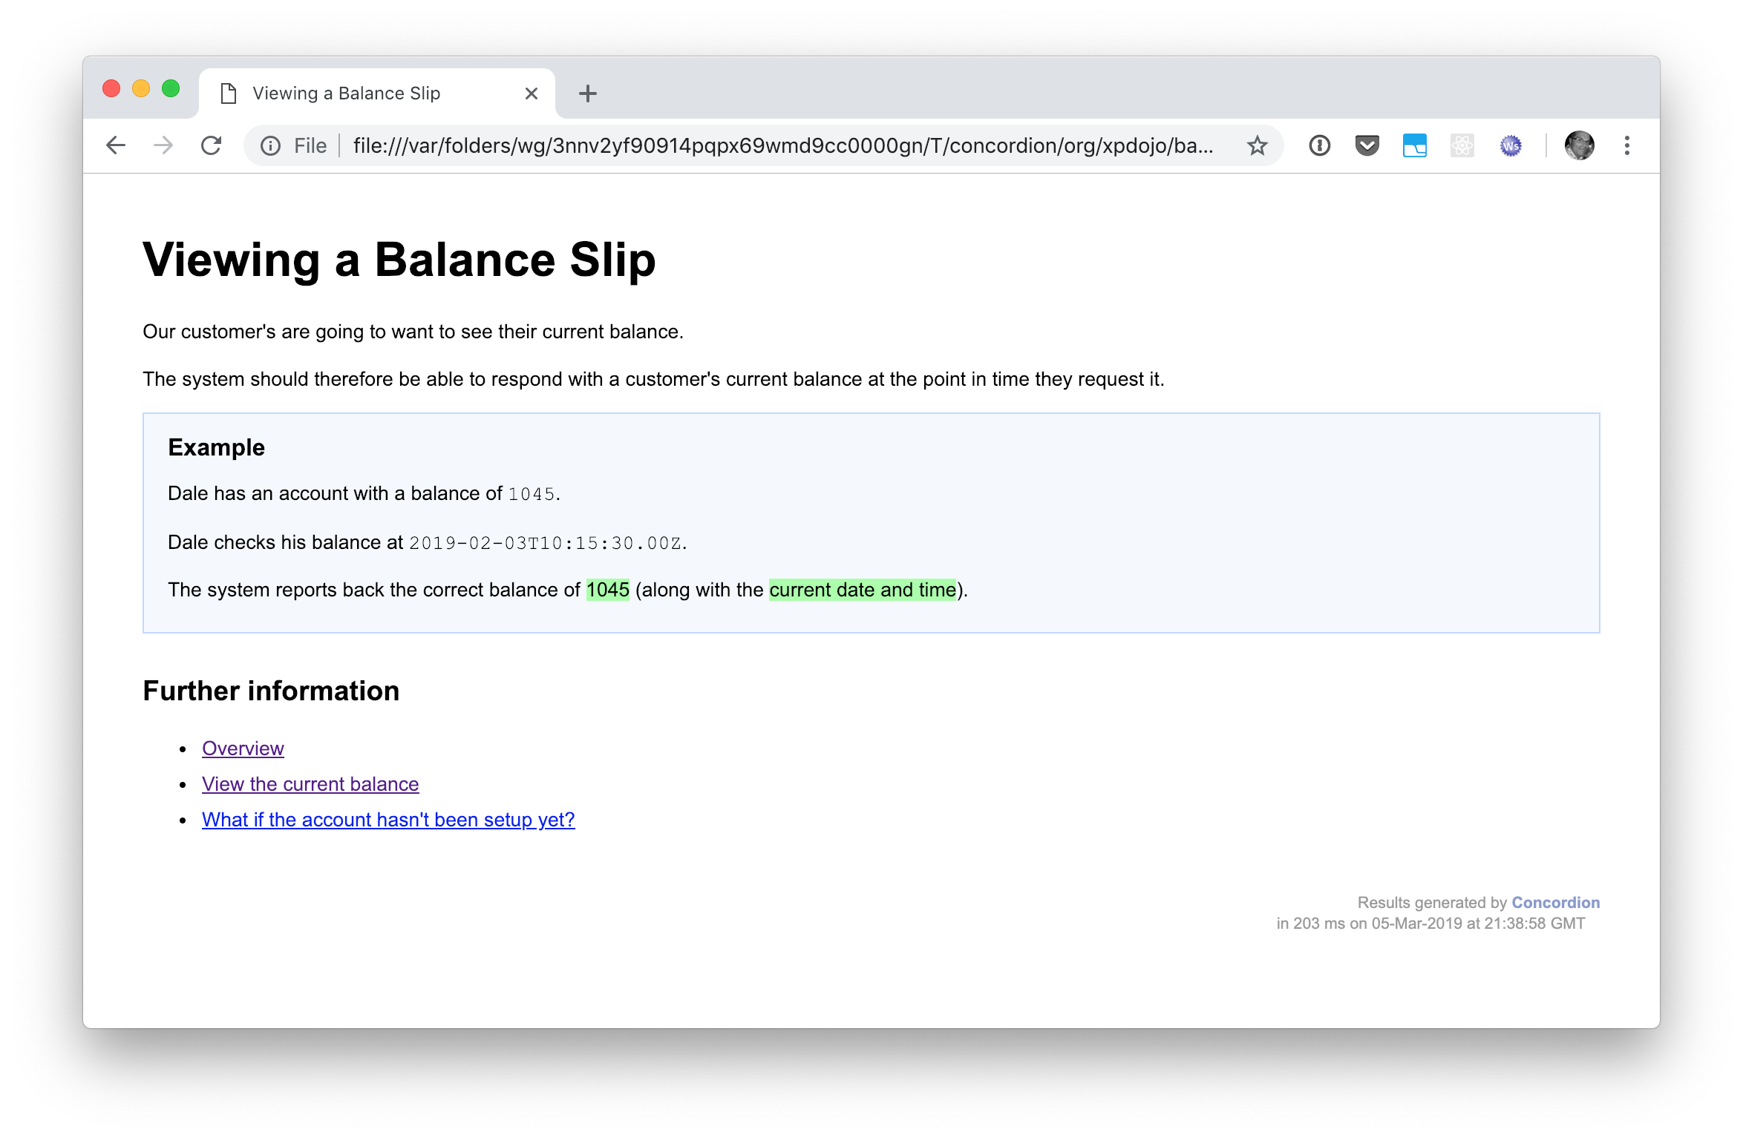
The Result
Notes:
This is the result of running the test

Slide 17
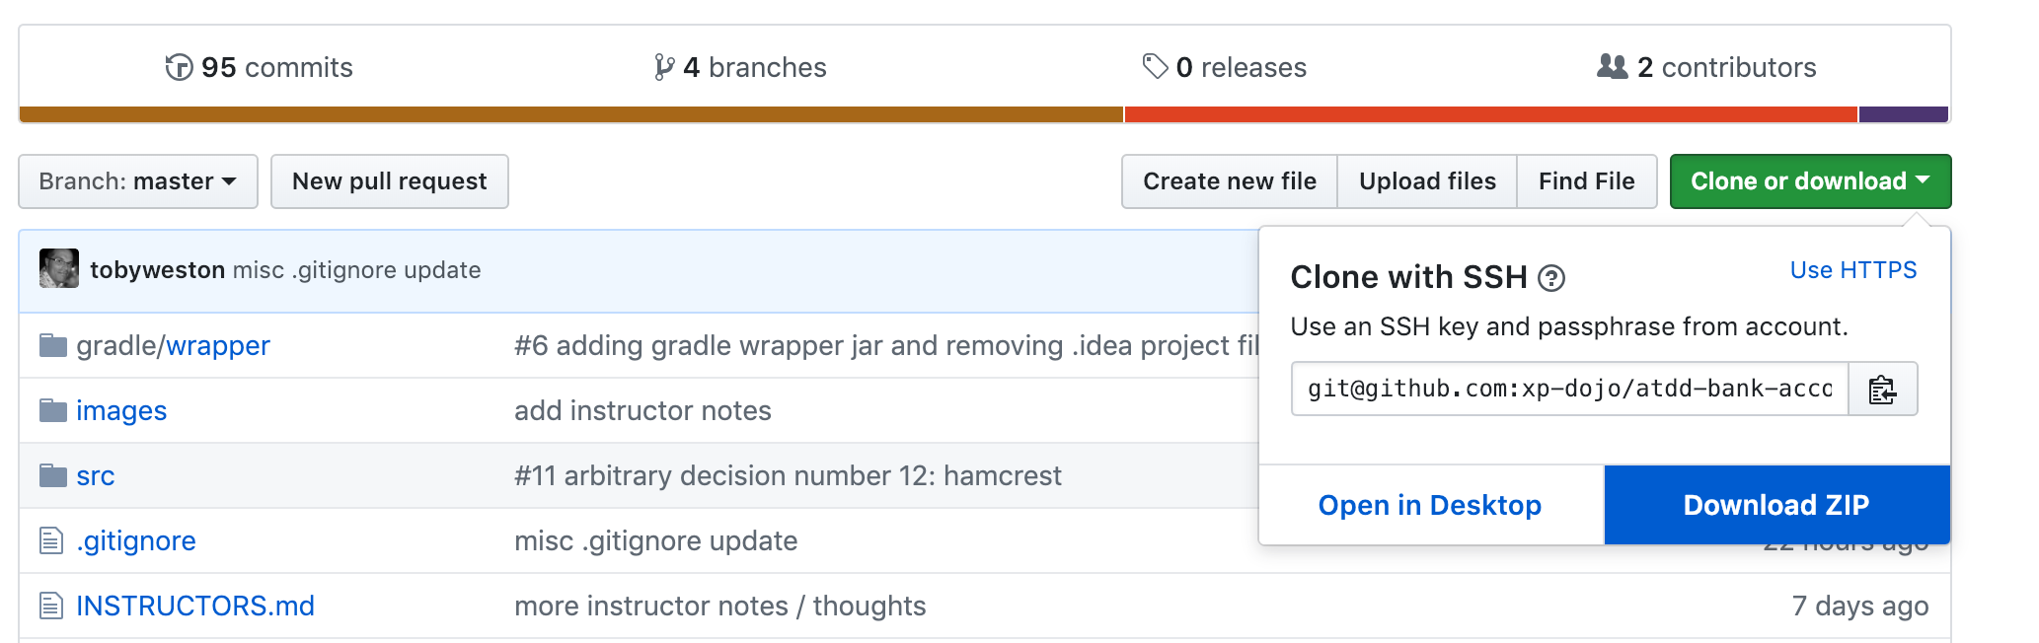
https://github.com/xp-dojo/atdd-bank-account
Notes:
Ok lets get coding
Last minute instructions (mention you can download the ZIP if you have problems)

Slide 18
Wrap-up
Understanding the basics of acceptance testing
Understanding how we agree acceptance criteria
Understand how to breakdown requirements
Understand the importance of iterating on understanding
Understand the correct application of abstraction in ATDD
Some pitfalls
Notes:
These should map to https://xpdojo.org/docs/lessons/02/atdd.html
Understanding the basics (of acceptance testing, what it is and its relationship with TDD)
Understanding how we agreeing acceptance criteria (with actual human customers and write those as living “specifications”)
Understand how to breakdown requirements (into small deliverables that can be demo’ed to the customer)
(related to the previous one) Understand the importance of iterating on our understanding (to get early feedback and “shift left”)
Understand the correct application of abstraction in ATDD (so that we can build large maintainable testing infrastructure that scales with our apps).
Some pitfalls

Slide 19

Wrap-up
example solutions

Slide 20
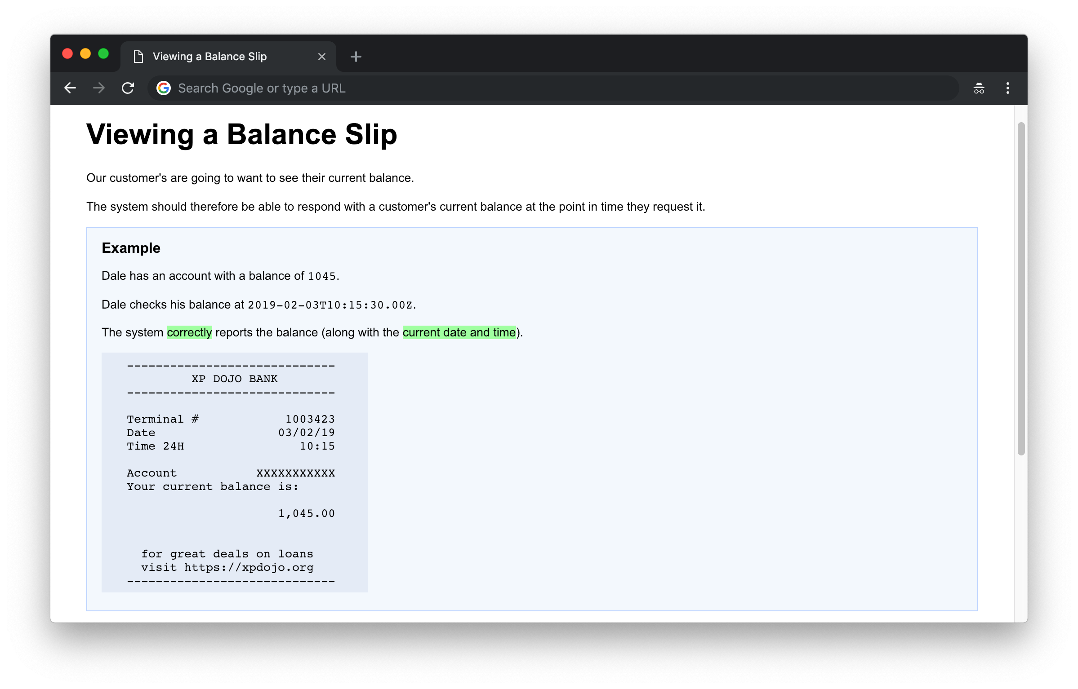
Notes:
Here’s the example of the balance slip acceptance test.
In this style, we push the assertions into ”fixture” layer but we log or echo the real output to the screen for discussion with the customer

Slide 21
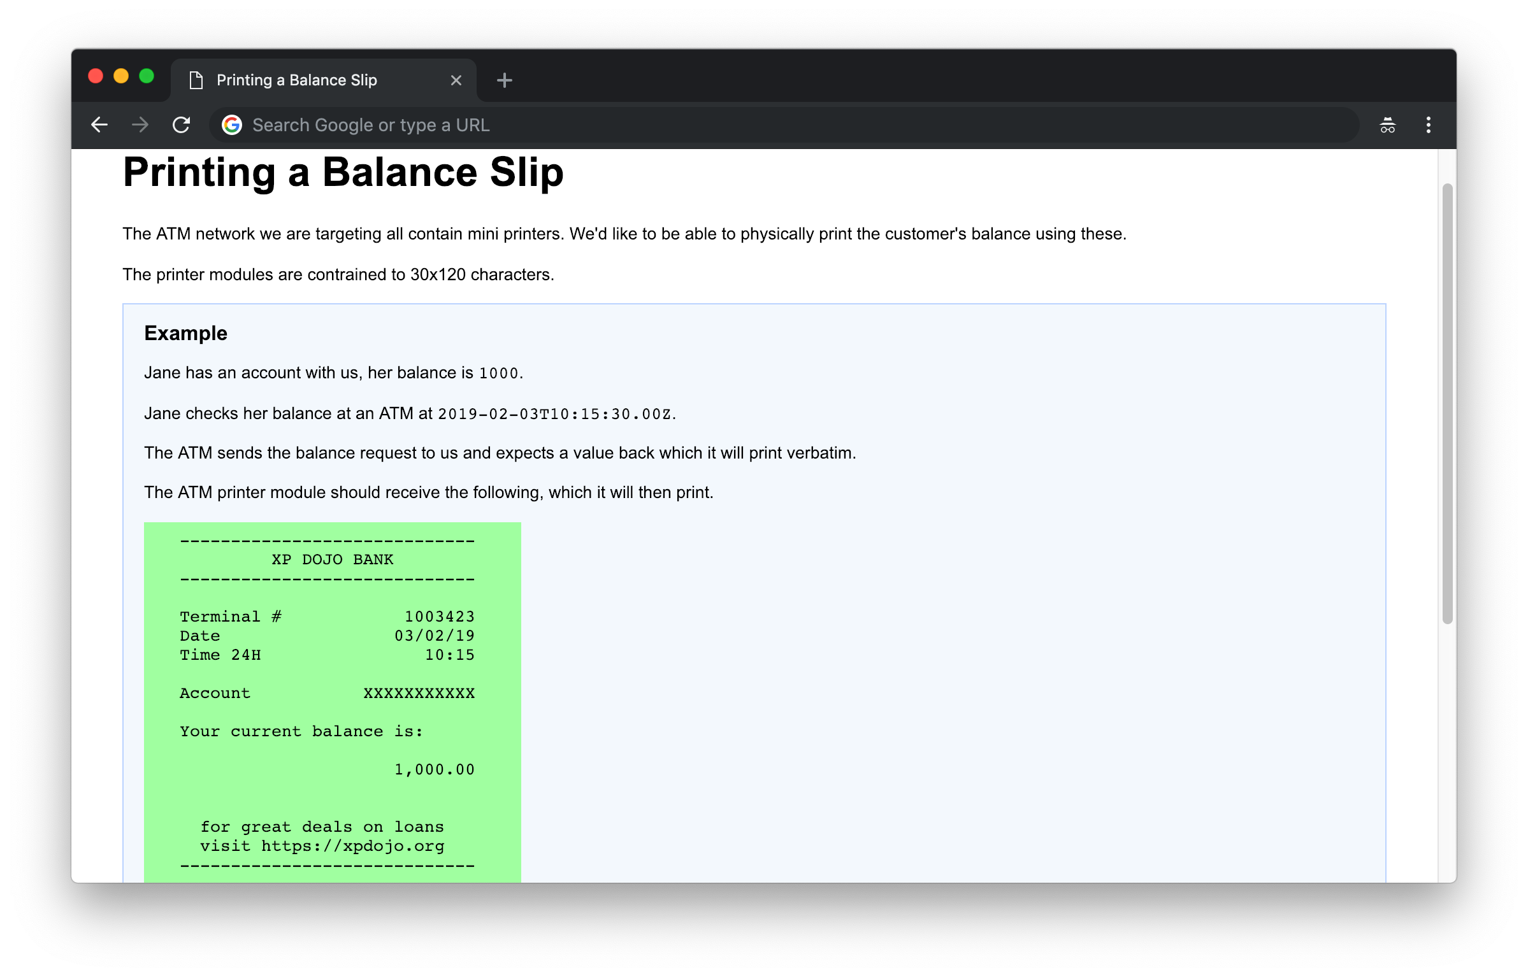

Slide 22
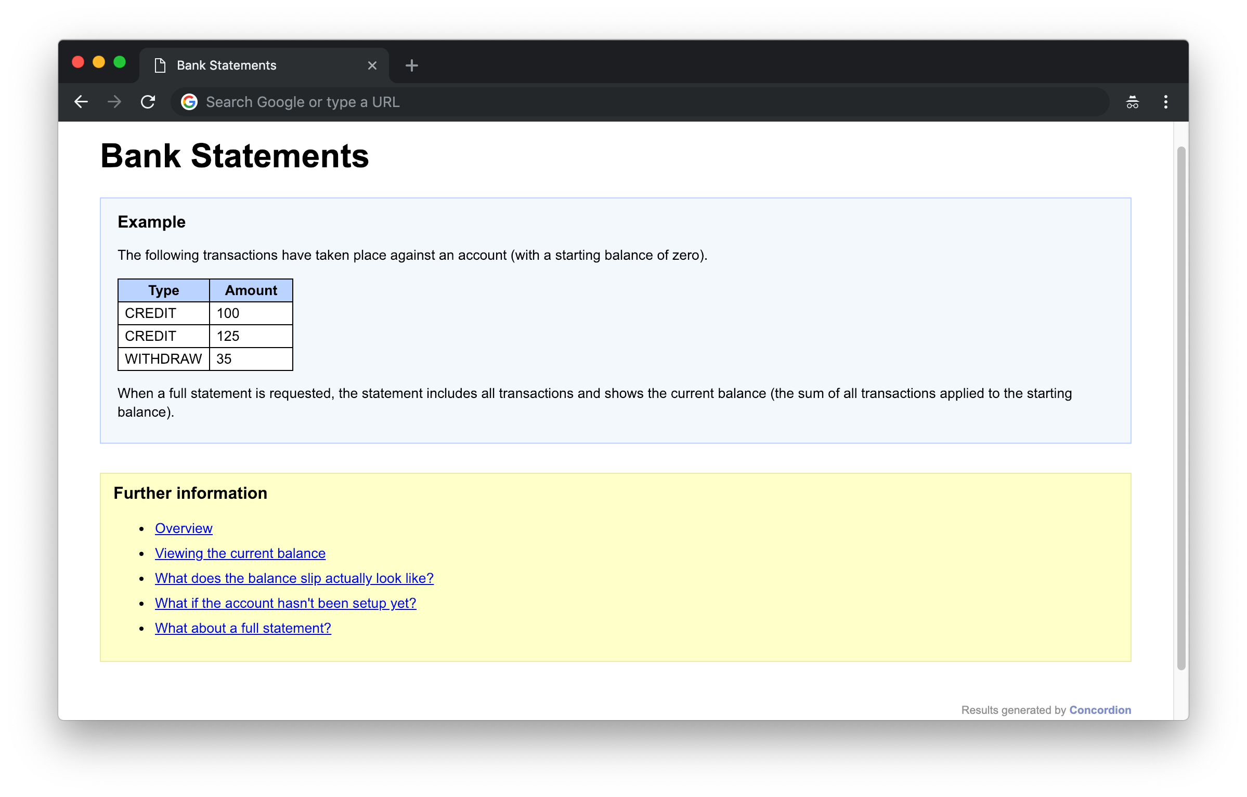
#1
Notes:
Iteration 1

Slide 23
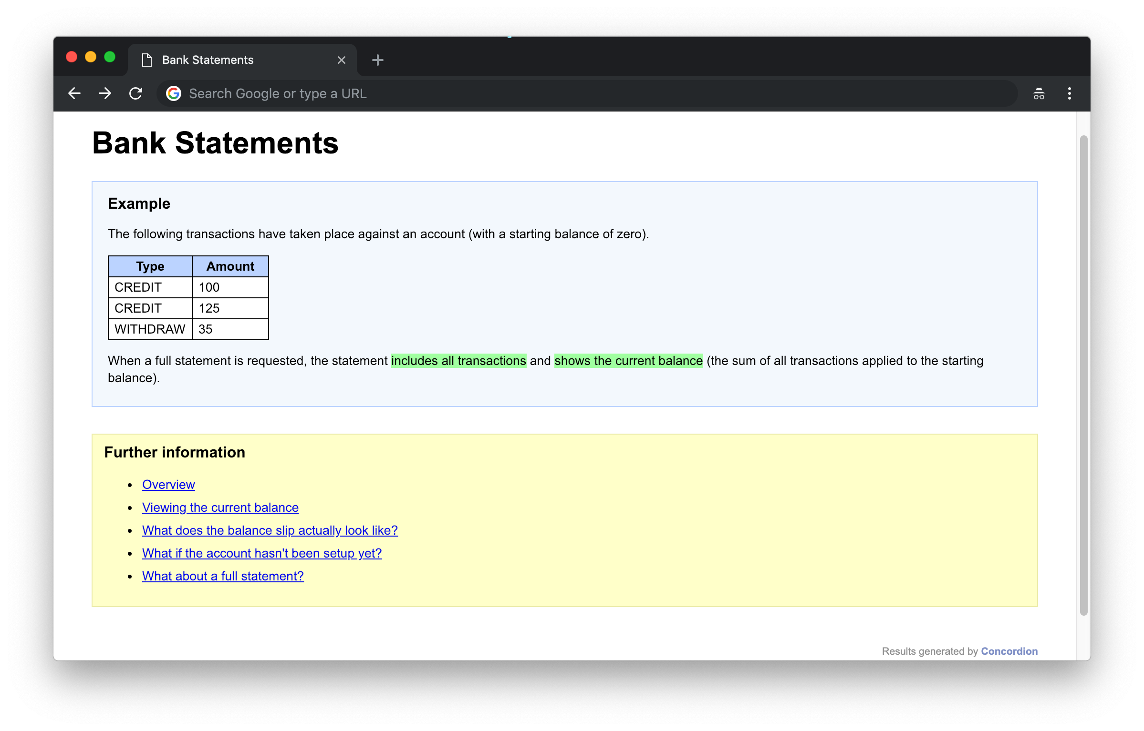
#1

Slide 24
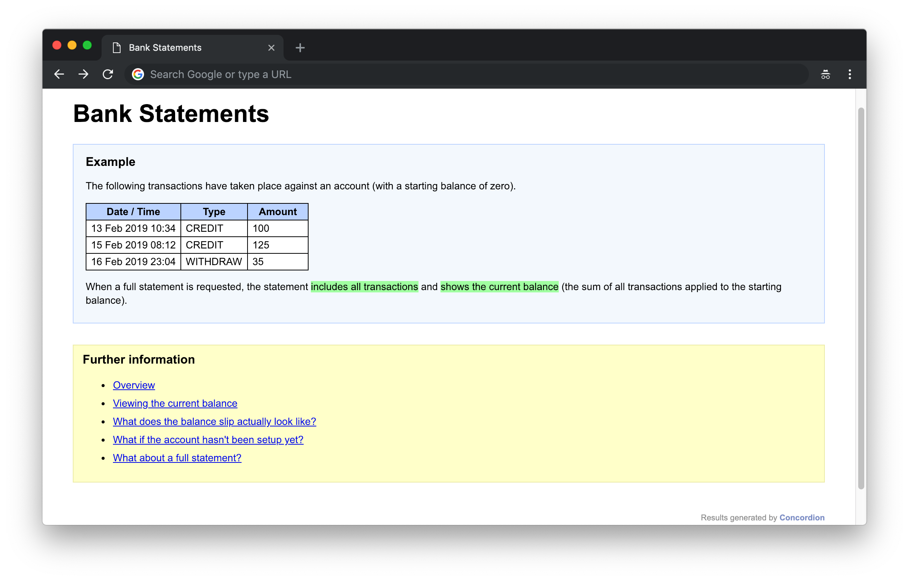
#2
Notes:
In the second iteration, we’ve added more data to a transaction line, but notice we haven’t changed the expectation.
We could have gone even further and included only CREDITs – the point is that we’re iterating here to refine our understanding of the problem. At each stage, we demo and agree with the customer.

Slide 25
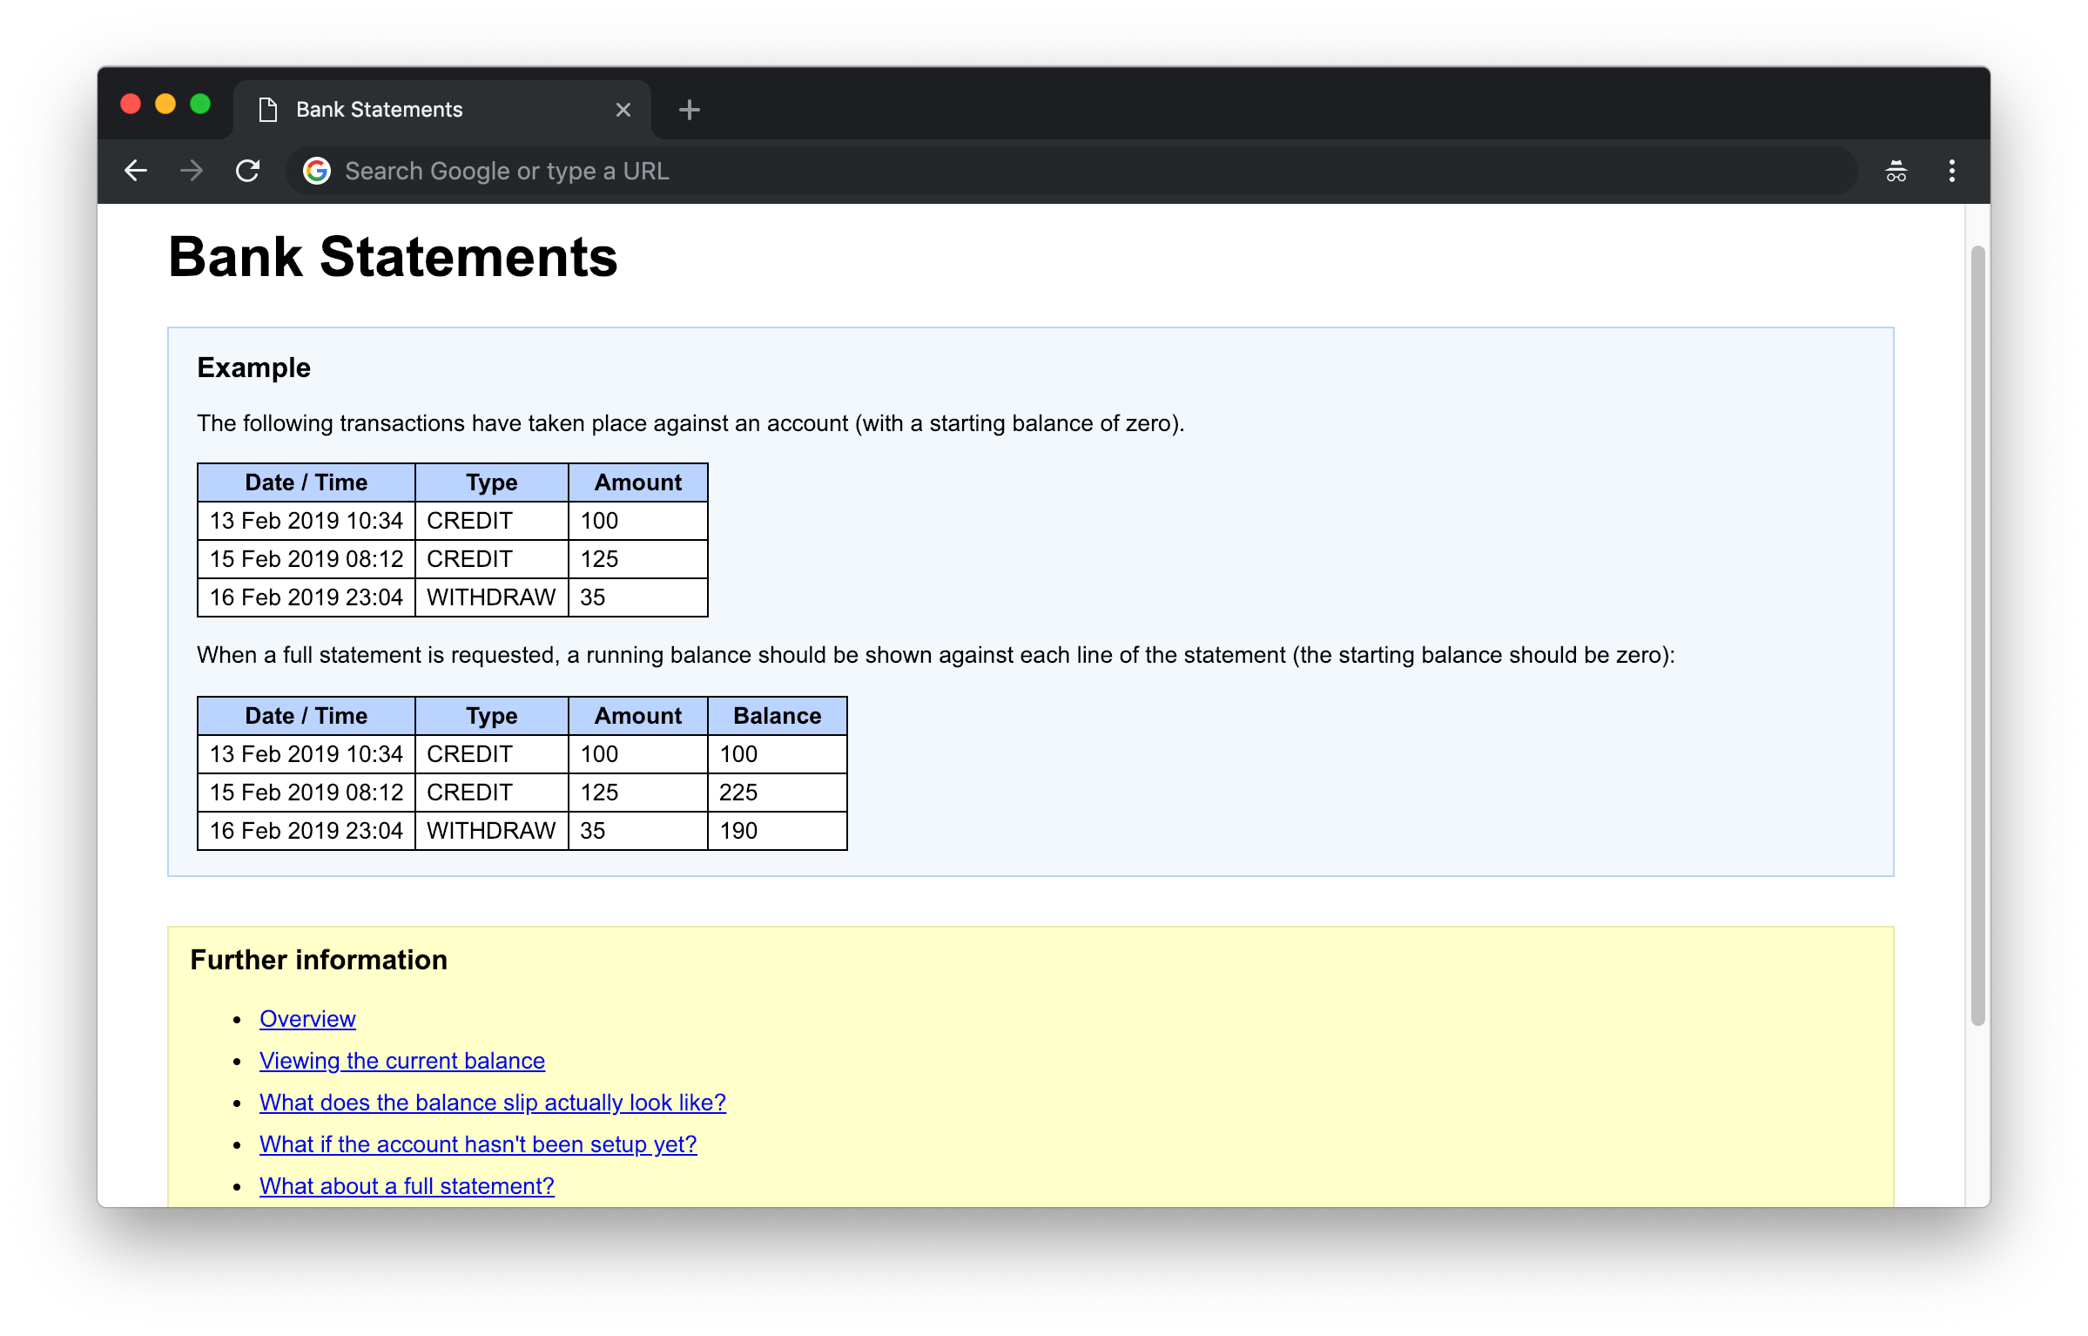
#3
Notes:
Iteration 3: with a running balance

Slide 26
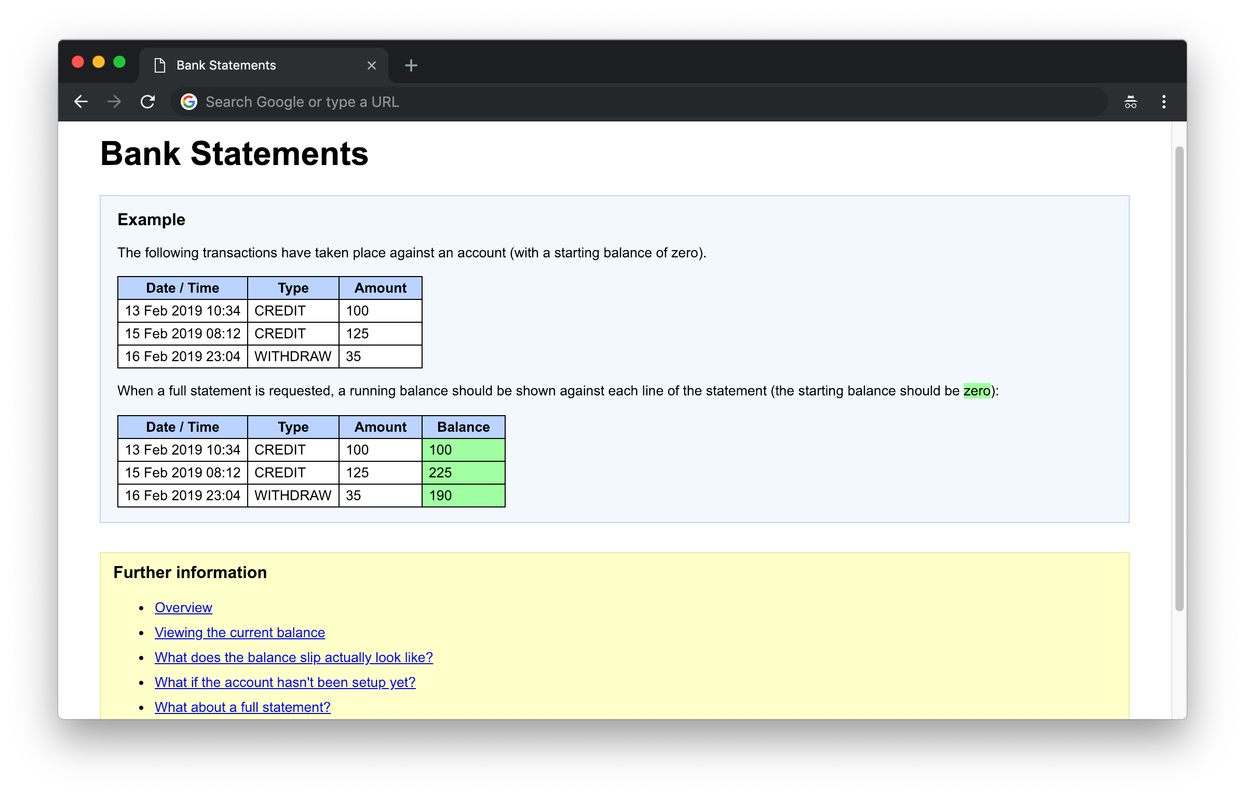
#3
Notes:
Iteration 3: with a running balance

Slide 27
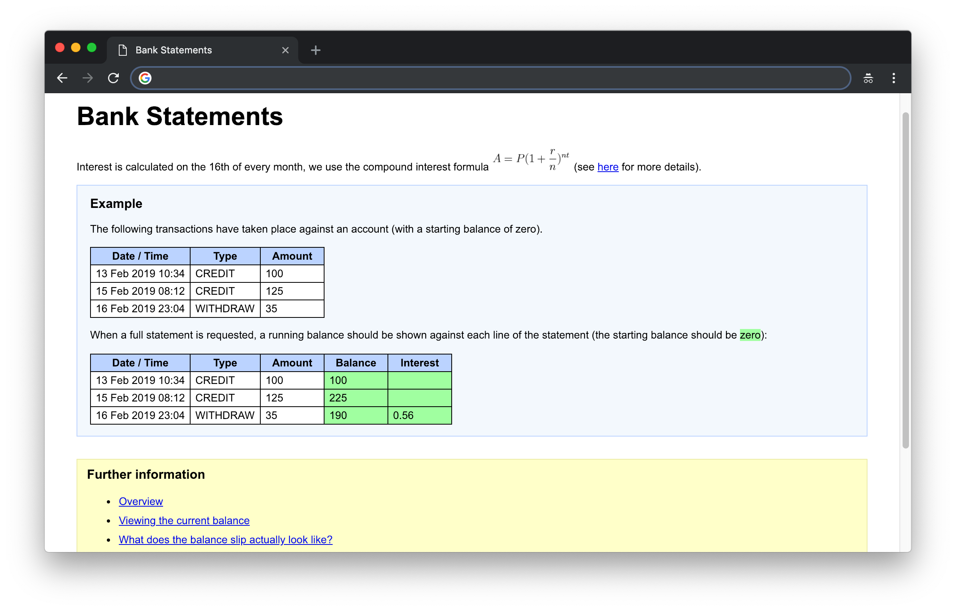
#4
Notes:
A more sophisticated example showing interest as well as a running balance. Note the description at the beginning.

Slide 28
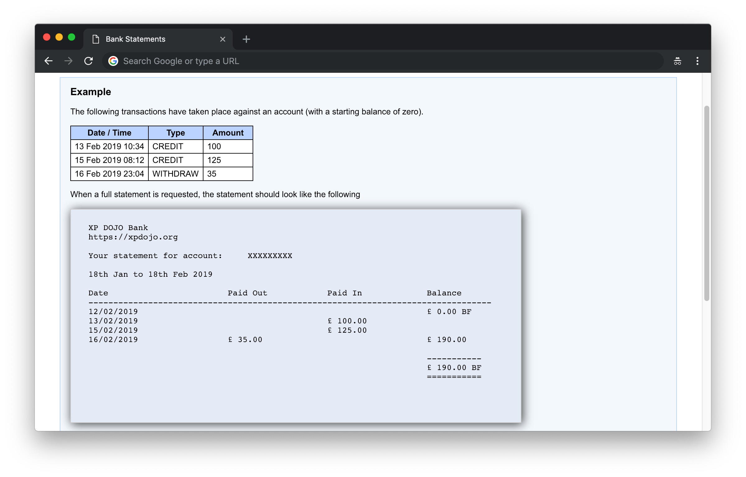
#4

Slide 29
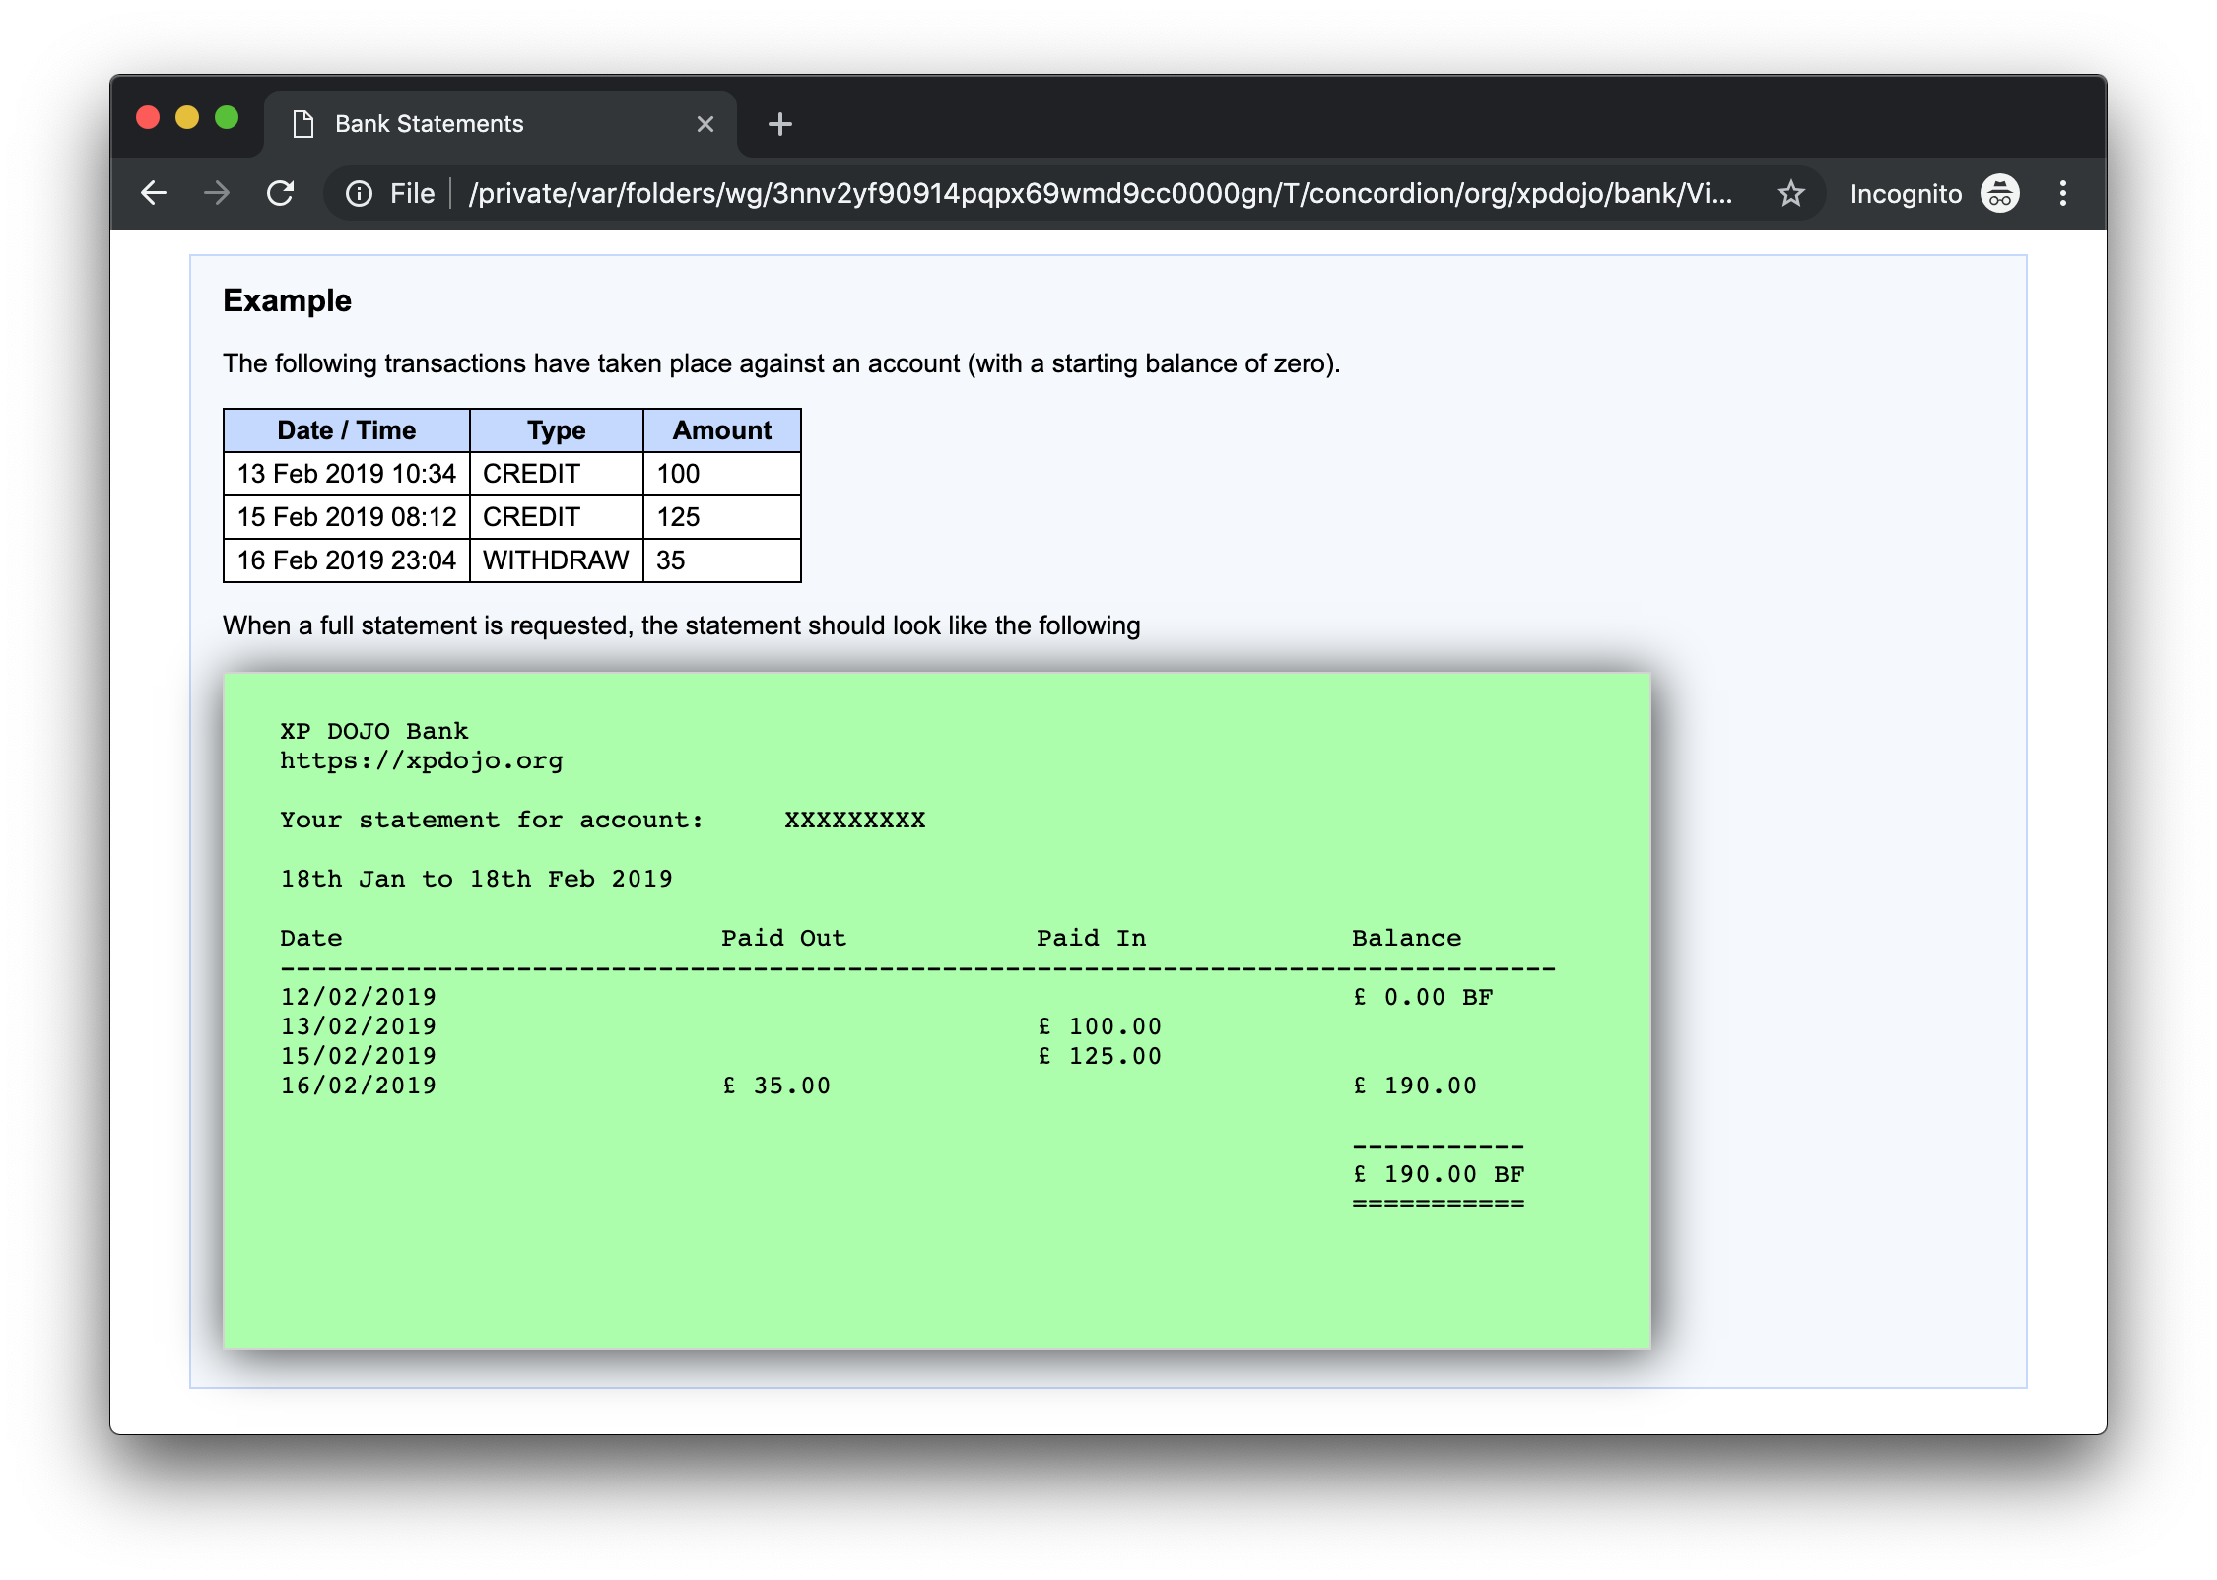
#4

Slide 30
Appendix

Slide 31
What do you think is meant by "test fixture"?
Notes:
What do you think is meant by "test fixture"?
In science, a fixture is often physical apparatus used to support a test specimen during an experiment. The experiment or test is distinct from the apparatus that supports it. Unit testing frameworks often muddy this idea because they expect tests to include test support code (the fixture part) as well as the actual test scenarios (the experiment part).

Slide 32
What do you think is meant by "test fixture"?
In science, a fixture is often physical apparatus used to support a test specimen during an experiment.
Notes:
What do you think is meant by "test fixture"?
In science, a fixture is often physical apparatus used to support a test specimen during an experiment. The experiment or test is distinct from the apparatus that supports it. Unit testing frameworks often muddy this idea because they expect tests to include test support code (the fixture part) as well as the actual test scenarios (the experiment part).

Slide 33
What do you think is meant by "test fixture"?
In science, a fixture is often physical apparatus used to support a test specimen during an experiment. The experiment or test is distinct from the apparatus that supports it.
Notes:
What do you think is meant by "test fixture"?
In science, a fixture is often physical apparatus used to support a test specimen during an experiment. The experiment or test is distinct from the apparatus that supports it. Unit testing frameworks often muddy this idea because they expect tests to include test support code (the fixture part) as well as the actual test scenarios (the experiment part).

Slide 34
What do you think is meant by "test fixture"?
In science, a fixture is often physical apparatus used to support a test specimen during an experiment. The experiment or test is distinct from the apparatus that supports it.
Unit testing frameworks often muddy this idea because they expect tests to include test support code (the fixture part) as well as the actual test scenarios (the experiment part).
Notes:
What do you think is meant by "test fixture"?
In science, a fixture is often physical apparatus used to support a test specimen during an experiment. The experiment or test is distinct from the apparatus that supports it. Unit testing frameworks often muddy this idea because they expect tests to include test support code (the fixture part) as well as the actual test scenarios (the experiment part).

